Slide 1
Python Final Project Demo
What is the next big food idea?

Slide 2

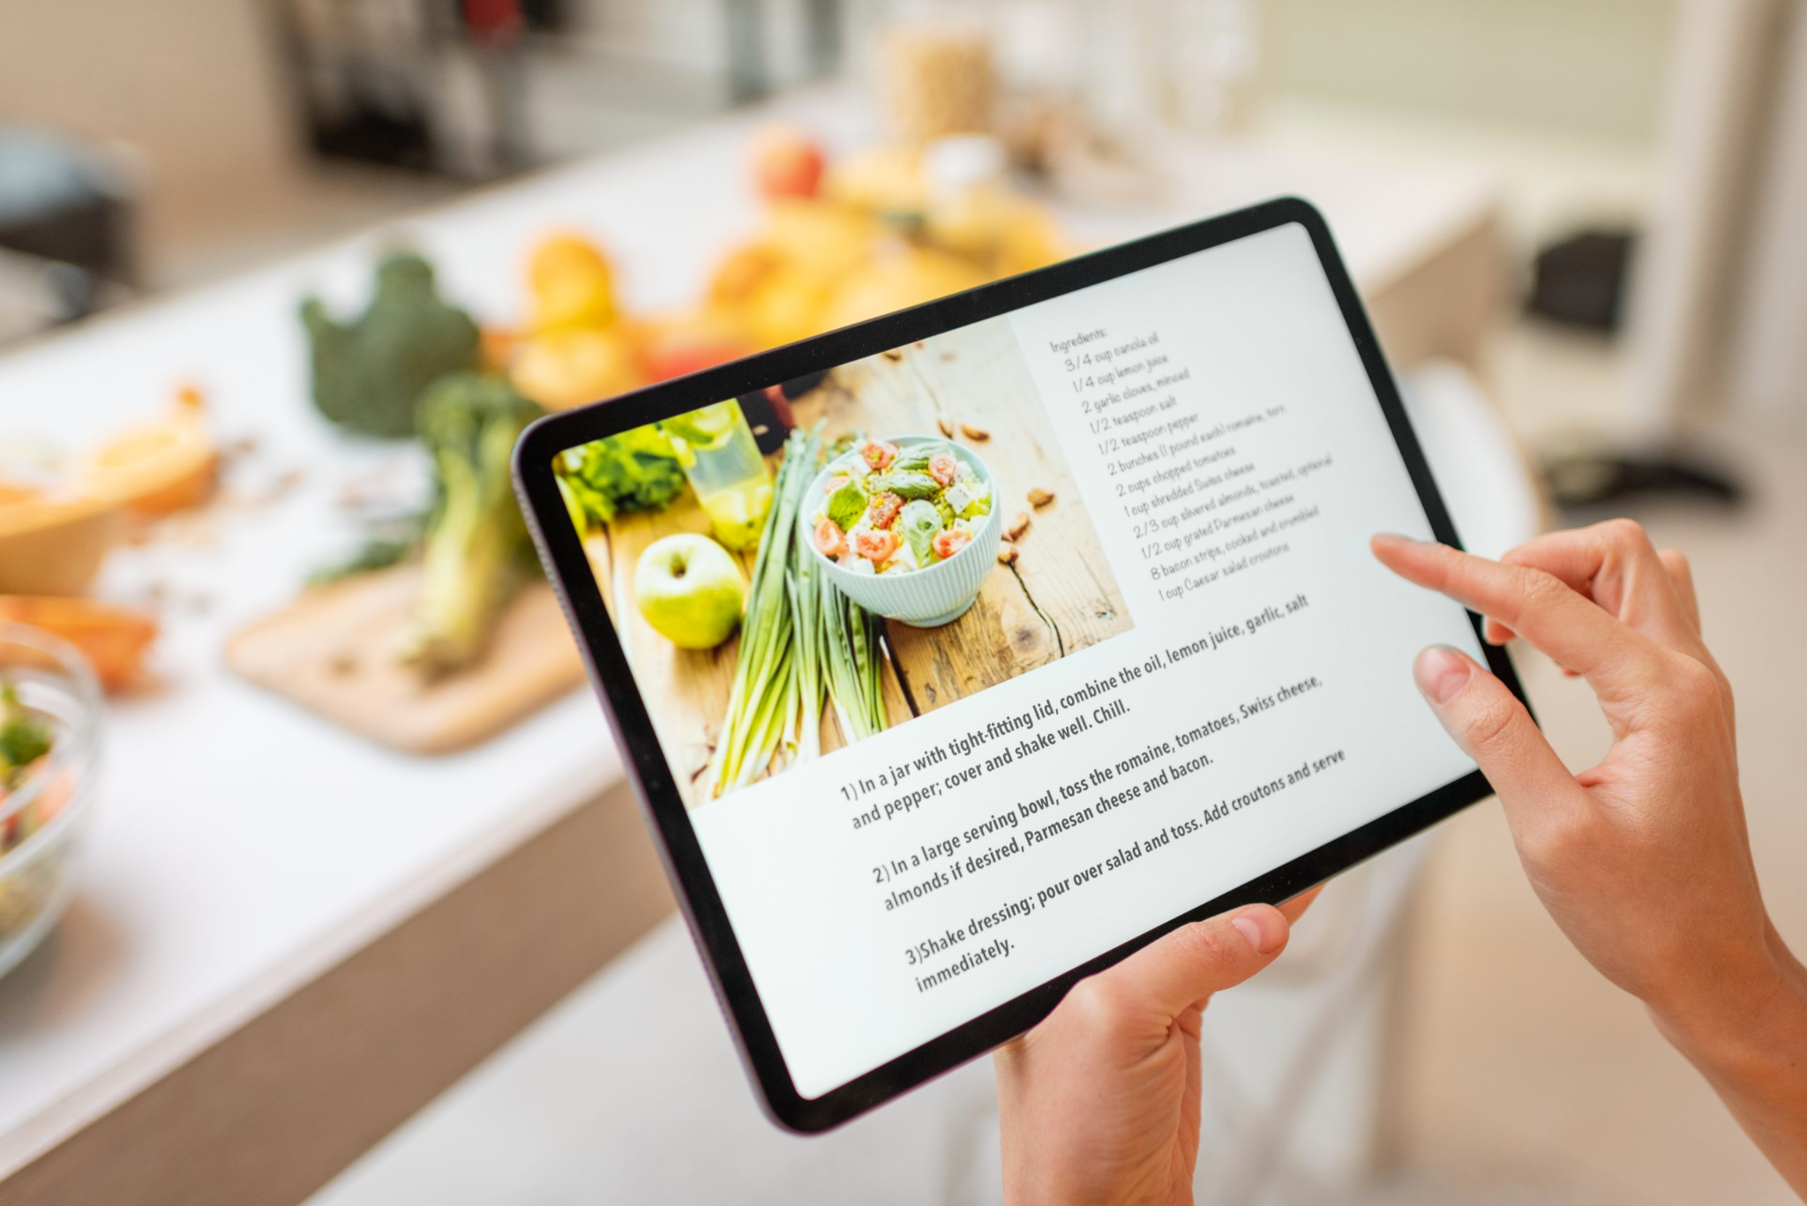
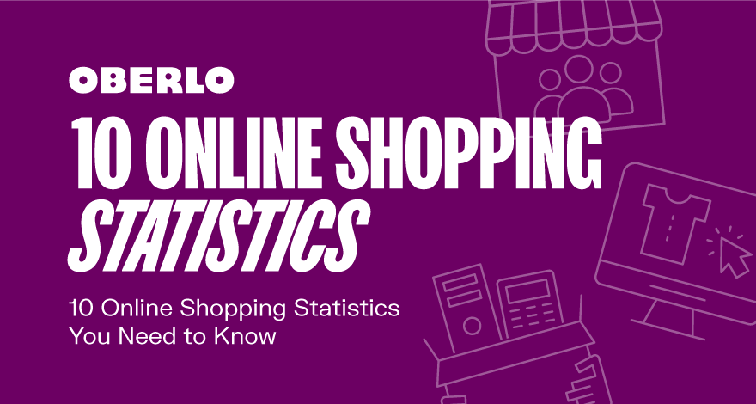
Food Product Development Dilemma
Food companies are uncertain about what types of products they should produce:
Millions of consumer purchases each year
Purchases fall under a number of different categories
Lots of data related to consumer behavior going unutilized:
Social media
Recipes
Grocery transactions and orders
Food ingredient lists currently available on the market

Slide 3

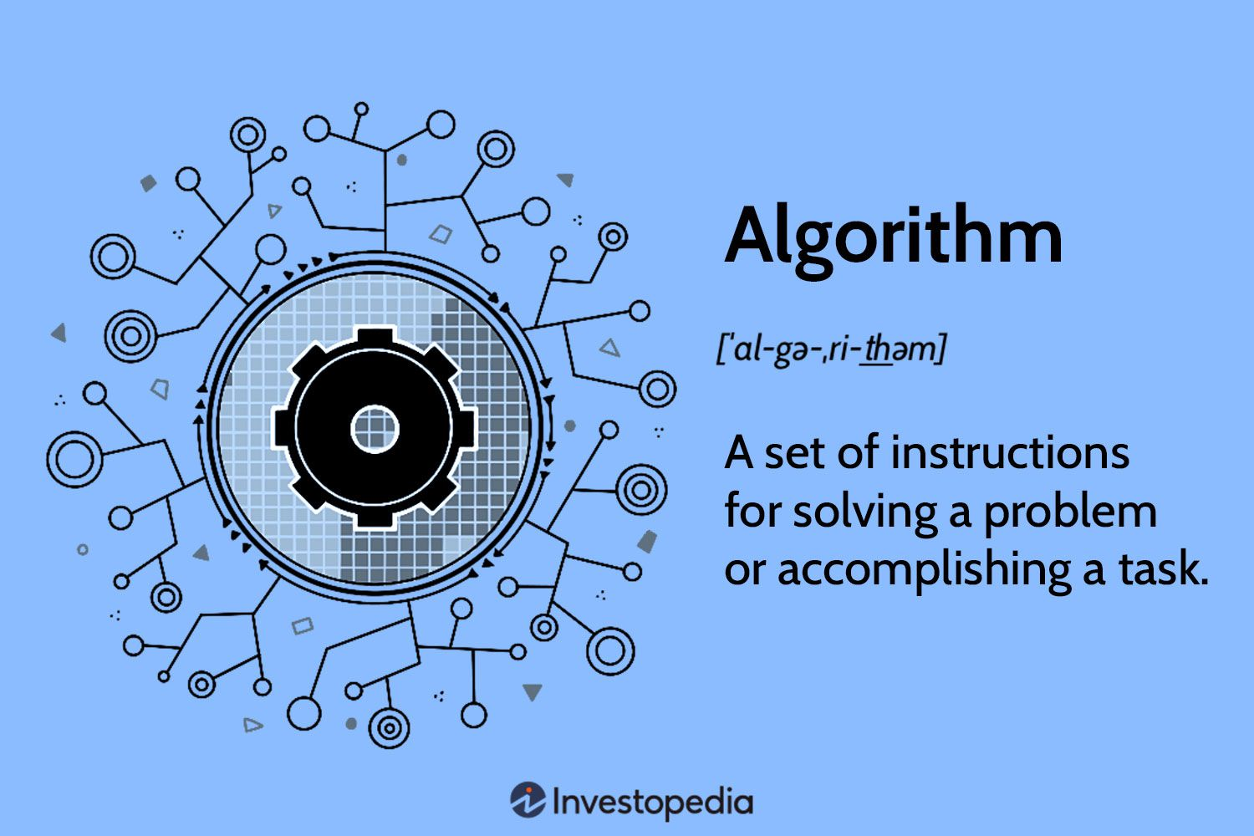
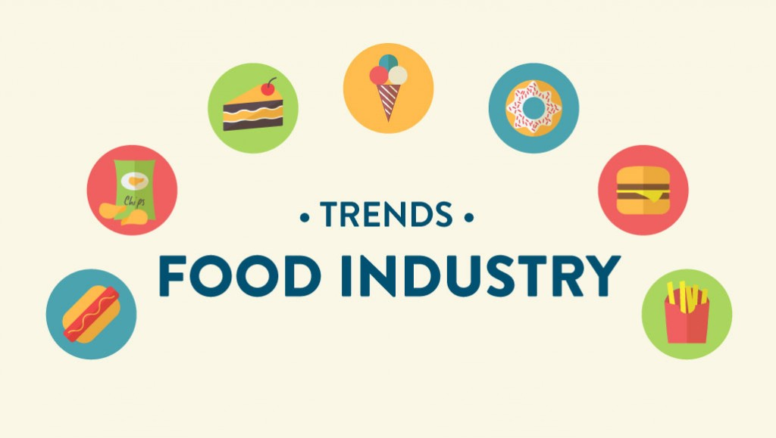
Goal of the program:
1.Analyzes grocery transactions to determine what the most popular food product/ingredient is
2.Categorizes each product/ingredient into the particular growing food industry subdivision
3.Ranks each food category in ascending order to determine which one is the most popular

Slide 4
Final Project Video
Please find my final project video in the link below:
https://youtu.be/en-IOYlEU-Y

